Slide 1
An Introduction to Shiny
Saranya Duraismy, Biogen
Nate Mockler, Biogen
PharmaSUG 2018
Paper #HT-03

Slide 2
Introduction

Slide 3
Sanity Check
Is your computer running?
Is it running Windows 7?
Can you run RStudio?
Can you load the shiny and shinydashboard packages?
Type library(shiny) and library(shinydashboard) into the Code part of RStudio

Slide 4
Note (Github)
All presentations, code, and solutions are on my Github
https://github.com/Nate884/PharmaSUG2018
All you need in one place.
Feel free to email at Nate.Mockler@biogen.com OR Saranya.Duraisamy@biogen.com

Slide 5
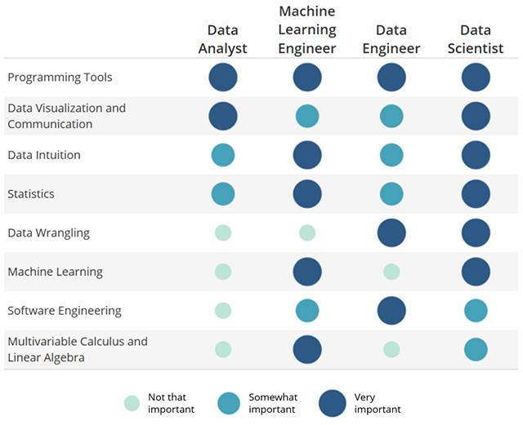
Who Are We?
Analysts at Biogen (One in Specialty Analytics, One in Data Management)
Prolific users of R to answer interesting questions and Shiny to let users do the analyses they want without bothering us asking us.

Slide 6
Agenda
Review of R/Dashboards
Introduction to Shiny/Widgets
Exercise 1
Extending it to extensions
Exercise 2
Adding the dashboard part
Exercise 3

Slide 7

Review of R!
Base R is great, but limited so we extend with packages. Packages are collections of R functions, data, and compiled code in a well-defined format.
We call them in using the library (<package>) statement
Examples: ggplot2, tidyverse, shiny…. Etc.
Rstudio is a free Graphical User Interface for R.
Similar to Enhanced Editor for SAS… can type scripts, see objects, etc.

Slide 8
Let’s Get Cracking
Go to “C:\HOW\Day2\HR03….\ Ex1_P.R and run it
What happened?
We will use this as a reference.

Slide 9
Review of Functions

Slide 10
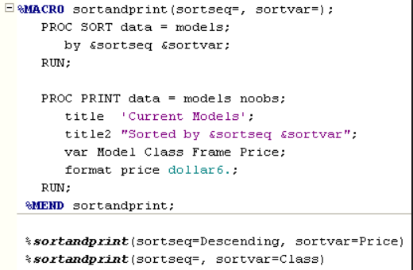
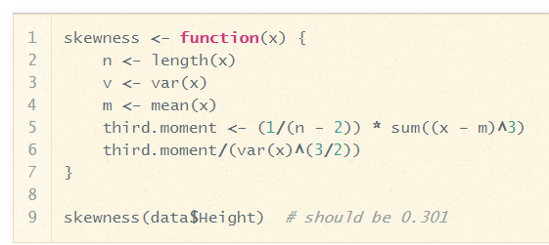
Macros (SAS) vs Custom Functions (R)
Functions in R
Macros in SAS

Slide 11
Part 2: Introduction to Shiny

Slide 12
What is Shiny?
Shiny is a web application framework for R, developed by RStudio
Allows you to combine the interactive functionality of the web with the statistical power of R without having to learn another language.
Right now, Shiny will use your personal computer as a server, but you can set this up on your company’s Intranet, or online (shinyapps.io)
Who has time to learn another language?

Slide 13

Me trying to learn another language after SAS and R

Slide 14
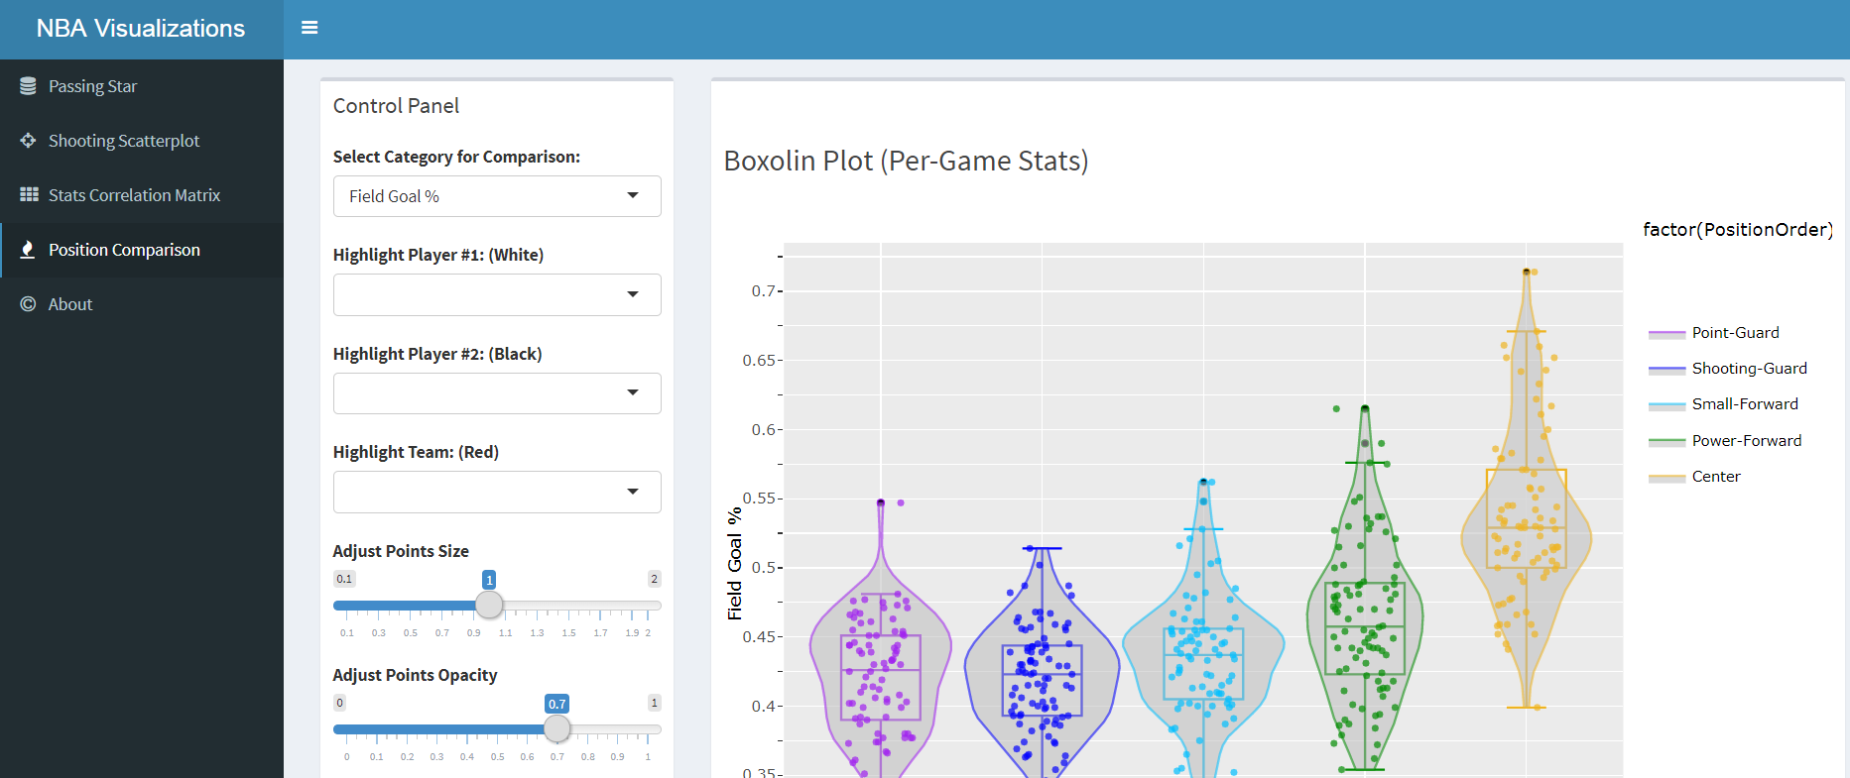
Example

Slide 15
Challenge that Exercise 1 Answers
Create a program that will let the user select what the second column of a table is.

Slide 16
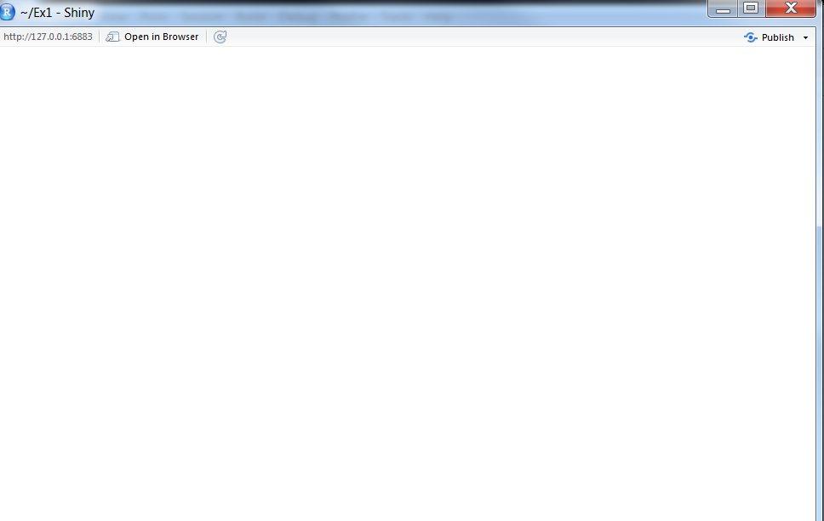
Building the app from Scratch
library(shiny)
ui <- fluidPage(
)
server <- function(input, output) {
}
# Run the application
shinyApp(ui = ui, server = server)

Slide 17
UI and Server (The Circle of Life)

Slide 18
Read in SAS data
library(shiny)
library(haven)
dm <- read_sas("J:/drug/study/R_training/dm.sas7bdat")
ui <- fluidPage(
)
server <- function(input, output) {
}
# Run the application
shinyApp(ui = ui, server = server)

Slide 19
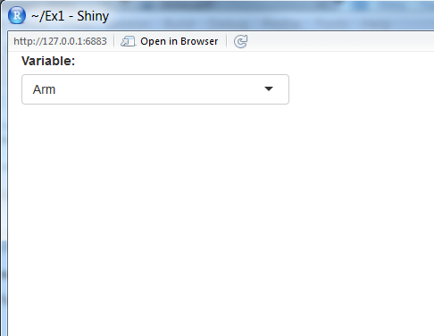
Adding a input
library(shiny)
library(haven)
dm <- read_sas("J:/drug/study/R_training/dm.sas7bdat")
ui <- fluidPage( selectInput("variable", "Variable:",
c("Arm" = "ARM",
"Country" = "COUNTRY",
"Race" = "RACE"))
)
server <- function(input, output) {
}
# Run the application
shinyApp(ui = ui, server = server)

Slide 20
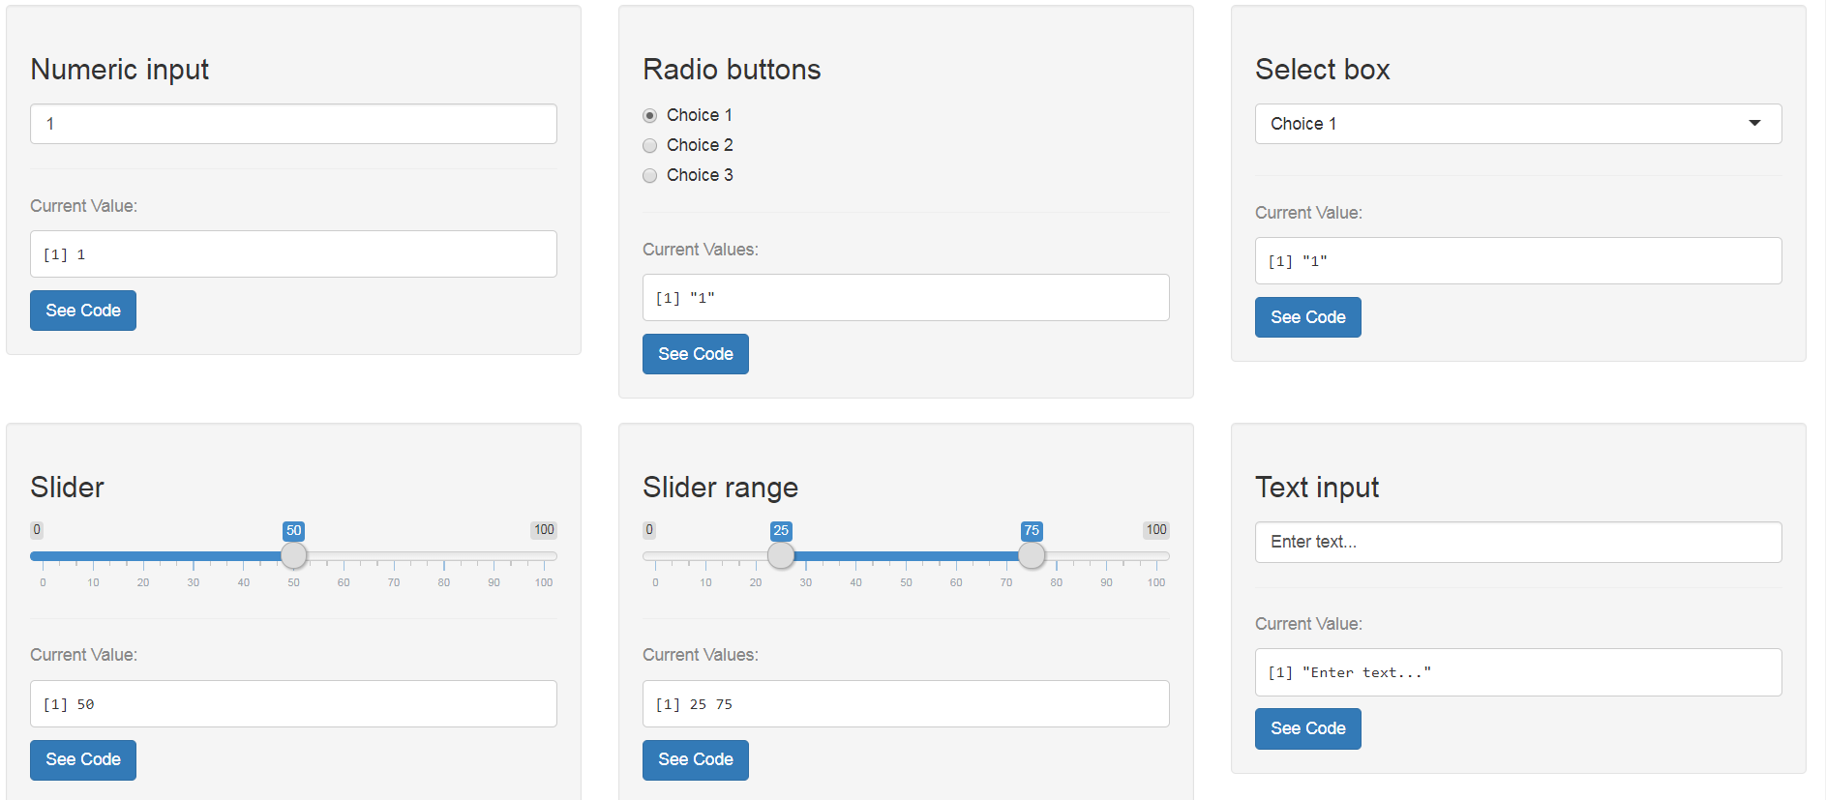
Widgets

Slide 21
Creating a Table
library(shiny)
library(haven)
dm <- read_sas("J:/drug/study/R_training/dm.sas7bdat")
ui <- fluidPage( selectInput("variable", "Variable:",
c("Arm" = "ARM",
"Country" = "COUNTRY",
"Race" = "RACE"))
)
server <- function(input, output) {
output$data <- renderTable({
dm[, c("USUBJID", input$variable), drop = FALSE]
}, rownames = TRUE)
}
# Run the application
shinyApp(ui = ui, server = server)

Slide 22
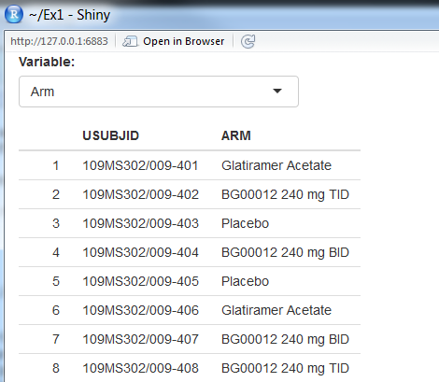
Actually Displaying the Table
library(shiny)
library(haven)
dm <- read_sas("J:/drug/study/R_training/dm.sas7bdat")
ui <- fluidPage(
selectInput("variable", "Variable:",
c("Arm" = "ARM",
"Country" = "COUNTRY",
"Race" = "RACE")),
tableOutput("data")
)
server <- function(input, output) {
output$data <- renderTable({
dm[, c("USUBJID", input$variable), drop = FALSE]
}, rownames = TRUE)
}
# Run the application
shinyApp(ui = ui, server = server)

Slide 23
How to Create A Custom Shiny App
Go to Rstudio -> New File -> Shiny Web App…
You can have it split into 2 files or one file. I prefer one.
Call it PharmaSUG

Slide 24
Exercise 1: Shiny Fundamentals
Load Exercise_1.R from C:\HOW\Day2\...
Run it and explore it
Step 1: Replace selectInput with RadioButton (all parameters are the same)
Bonus: Add Age as a variable to the ones output from DM to output$data
Reminder: the c() function combines arguments into a vector.

Slide 25

Congrats!
That’s the loop. Everything else is just adding additional inputs and outputs, or nesting it within a dashboard.

Slide 26
Extending the functionality
It is, in essence, just a frontend for R, so everything that you can do in R you can do in Shiny.
You can create tables, display plots, do machine learning… everything within the paradigm of shiny

Slide 27
How do we do this in Exercise 1?
Replace tableOutput with plotOutput
Replace renderTable with renderPlot

Slide 28
What we had before…
library(shiny)
library(haven)
dm <- read_sas("J:/drug/study/R_training/dm.sas7bdat")
ui <- fluidPage(
selectInput("variable", "Variable:",
c("Arm" = "ARM",
"Country" = "COUNTRY",
"Race" = "RACE")),
tableOutput("data")
)
server <- function(input, output) {
output$data <- renderTable({
dm[, c("USUBJID", input$variable), drop = FALSE]
}, rownames = TRUE)
}
# Run the application
shinyApp(ui = ui, server = server)

Slide 29
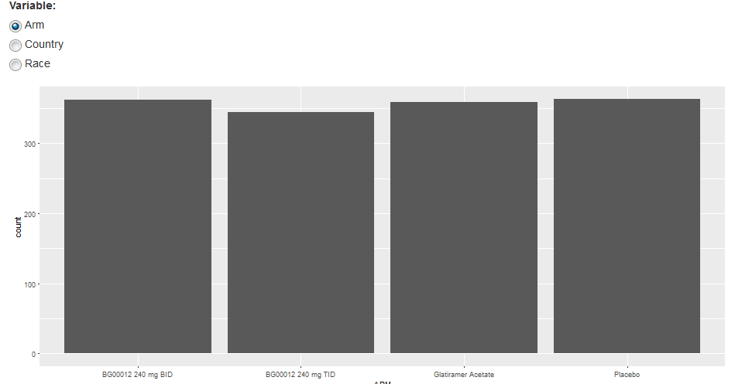
Let’s add a ggplot2 object
library(shiny)
library(haven)
dm <- read_sas("J:/drug/study/R_training/dm.sas7bdat")
ui <- fluidPage( radioButtons("variable", "Variable:",
c("Arm" = "ARM",
"Country" = "COUNTRY",
"Race" = "RACE")),
plotOutput("plot")
)
server <- function(input, output) {
output$plot <- renderPlot({
ggplot(dm, aes_string(input$variable)) + geom_bar()
})
}
# Run the application
shinyApp(ui = ui, server = server)

Slide 30
Exercise 2: Creating ggplot2 object
Take your program from exercise 2
Using our example, add a plot that will do a histogram of <variable> by sex (remember we need to use facet for this… see the ggplot2 cheat sheet)
Hint: there is a ggplot2 cheat sheet in Rstudio -> Help -> Cheatsheets
If you finish that…. Explore the other ggplot2 options and see how they affect the plot.

Slide 31
Adding the Dashboard
Here’s the fun part: Adding the concepts we learned, we can use additional packages to extend the functionality
The shinydashboard package adds a lot of the dashboard functionality

Slide 32
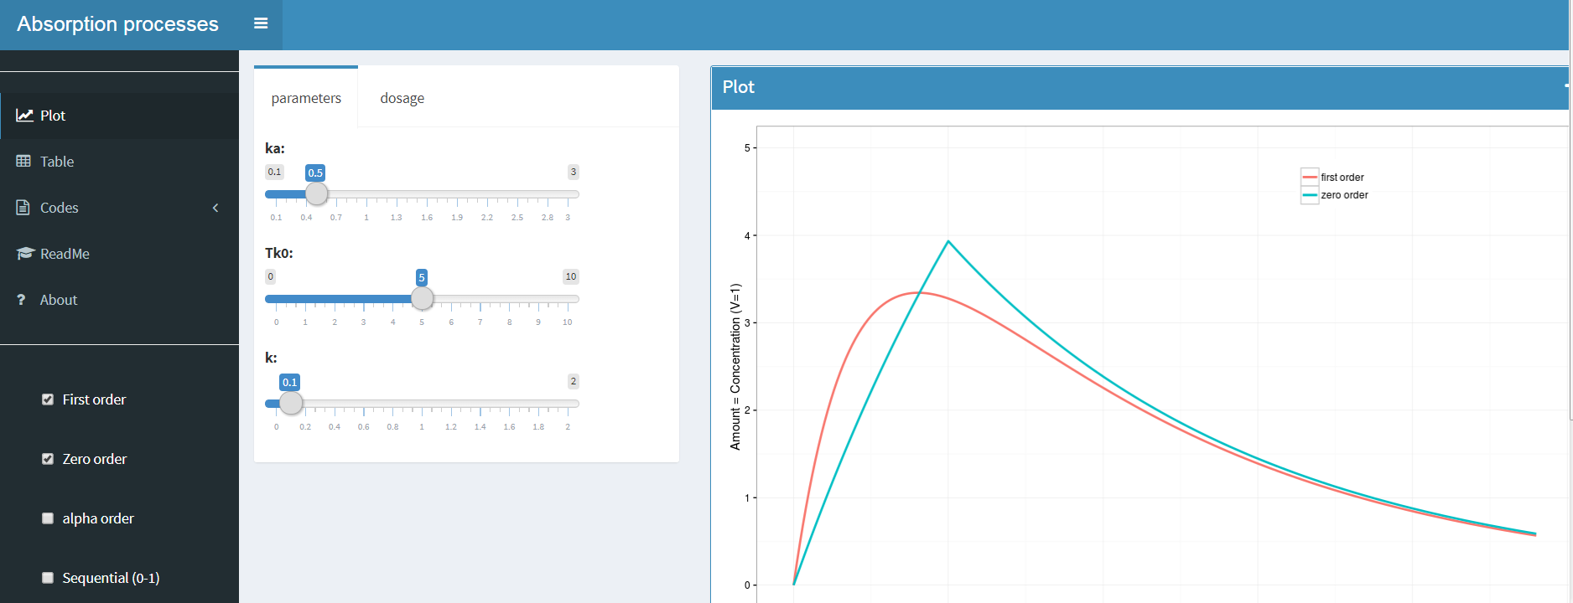
Shinydashboard Package

Slide 33
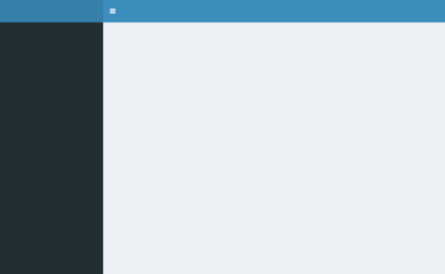
Breaking down the Shinydashboard
library(shiny)
library(shinydashboard)
ui <- dashboardPage(
dashboardHeader(),
dashboardSidebar(),
dashboardBody()
)
server <- function(input, output) { }
shinyApp(ui, server)

Slide 34
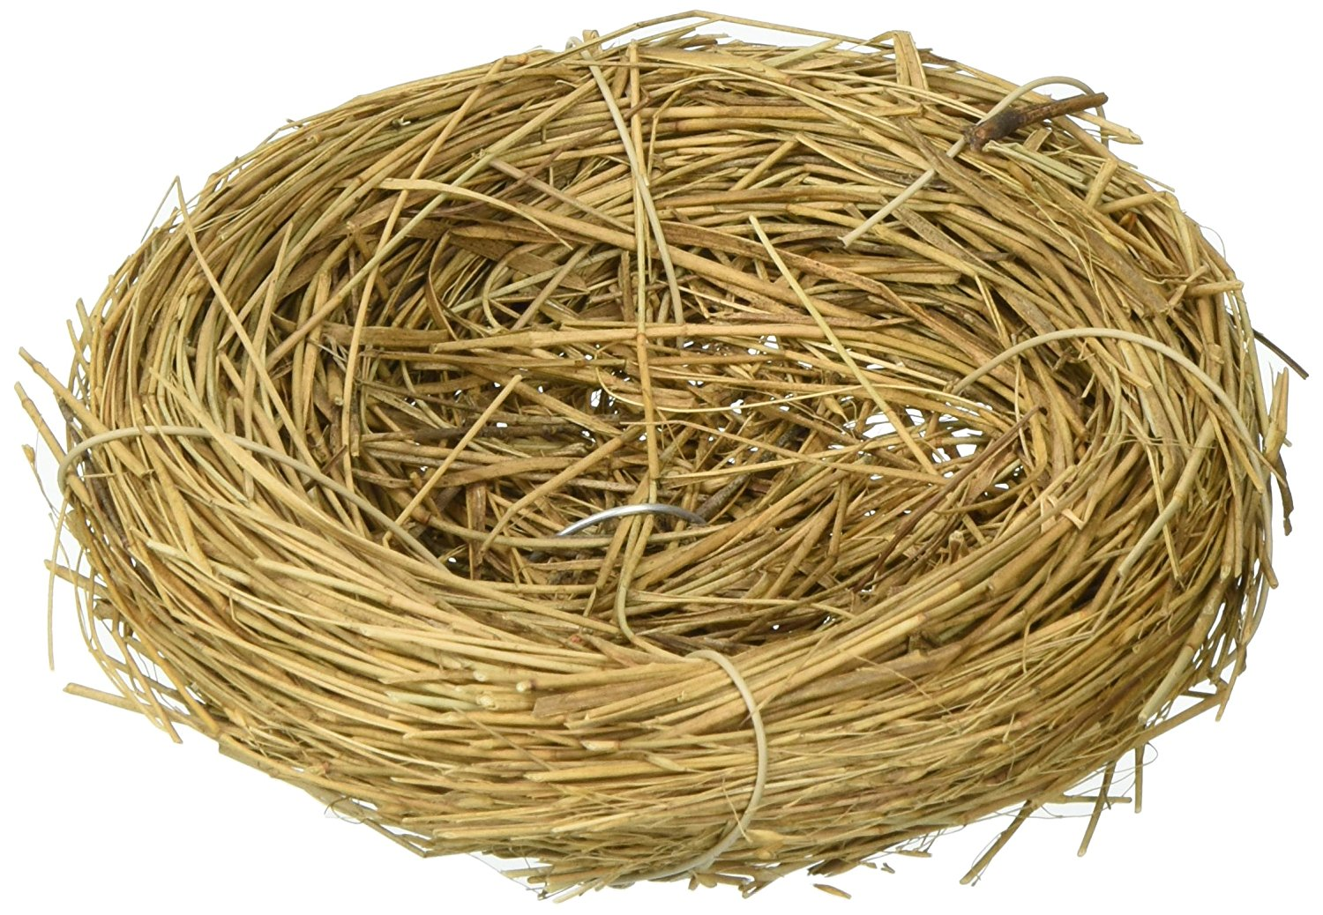
WARNING:

Slide 35
Exercise 3: Putting It all Together
Program Exercise_3.R has the latest shinydashboard basics
Add the graph from example 2 into the DashboardBody() section
Hint: Do not take the ui and server part… there already is one. You want to focus on the renderplot part.

Slide 36
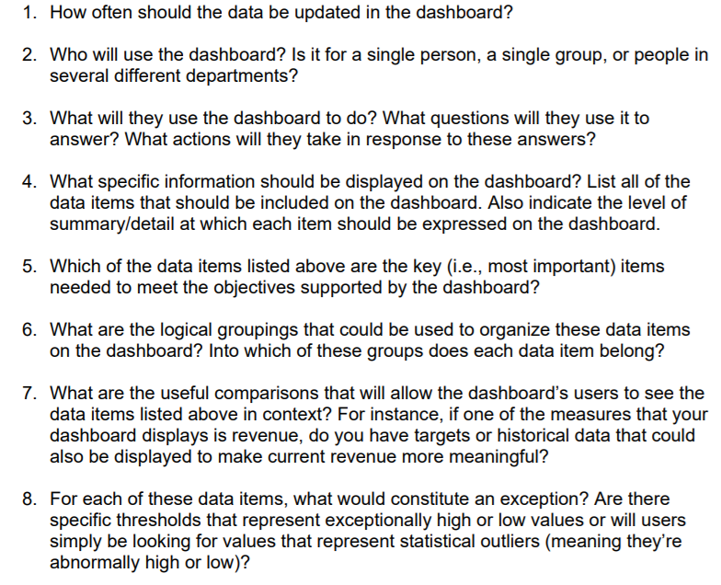
Questions to ask when you build (8 Questions)

Slide 37
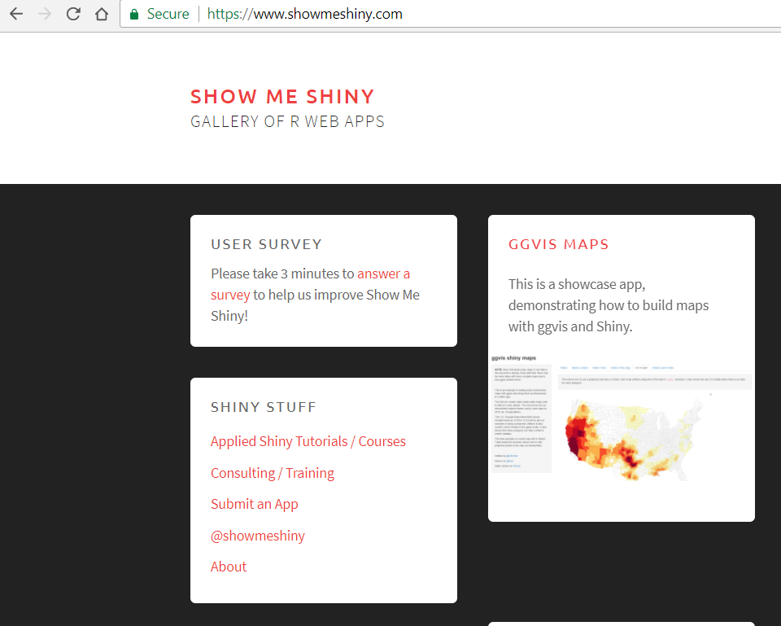
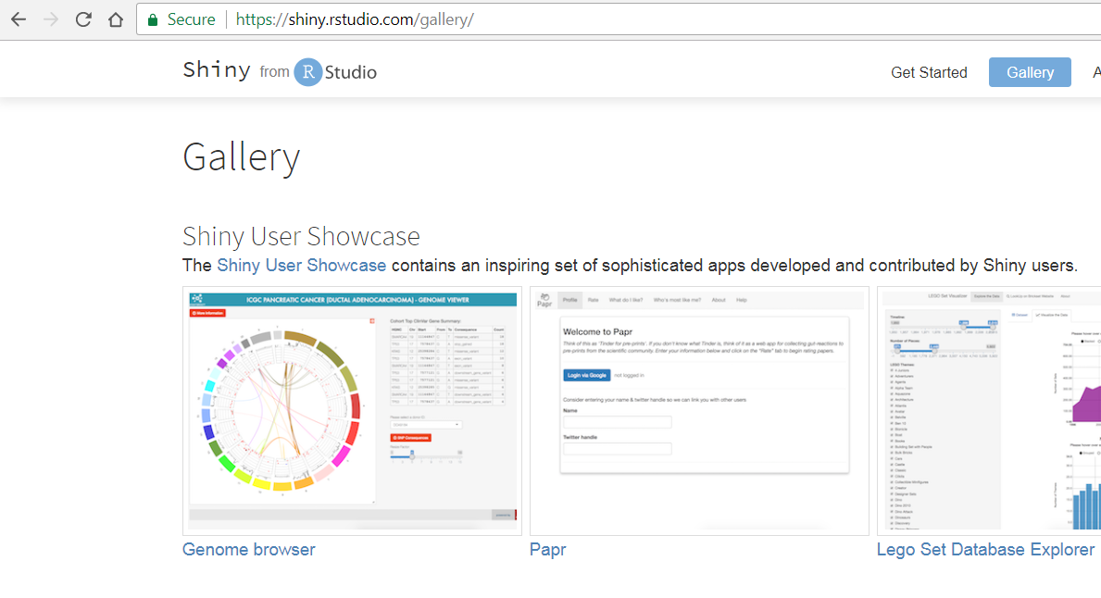
If you want to see Shiny Apps in Action…
Shiny.rstudio.com/gallery
www.showmeshiny.com

Slide 38
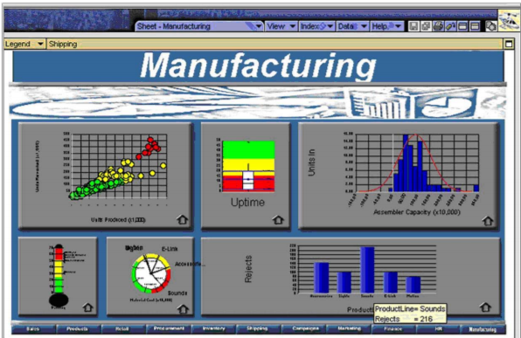
What makes a bad dashboard?
Stephen Few identified 13 ways a dashboard is bad

Slide 39
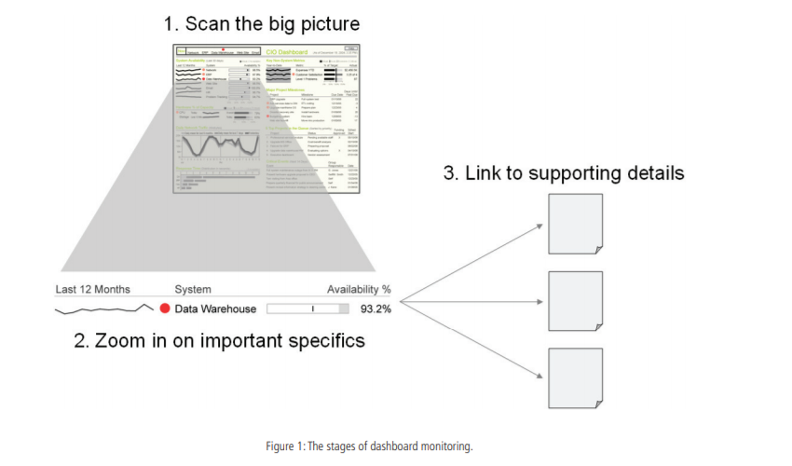
What makes a good dashboard?

Slide 40
For more Info
www.perceptualedge.com

Slide 41
Name: Nate Mockler and Saranya Duraisamy
Organization: Biogen
Web: Nate.Mockler@biogen.com & Saranya.Duraisamy@biogen.com

